Slide 1
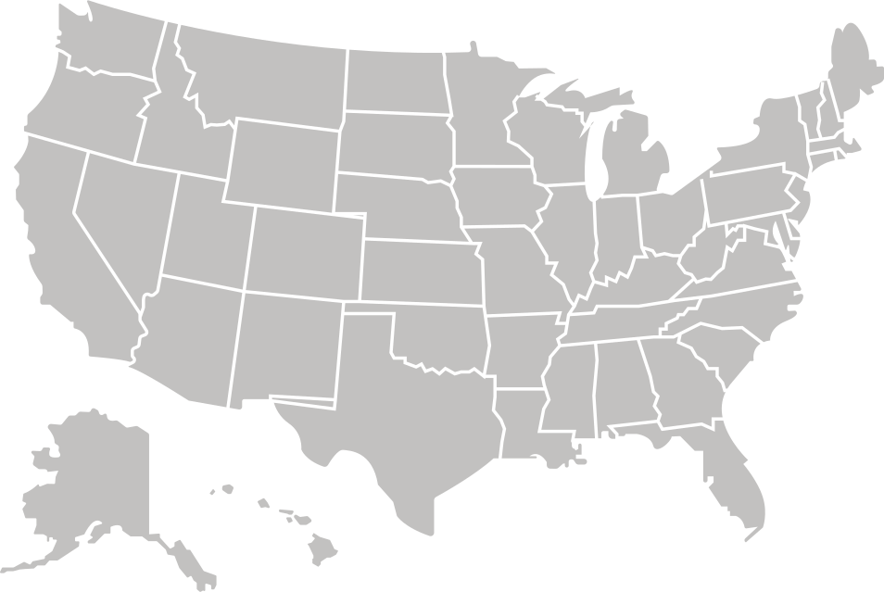


ANNUAL OFFERING
NAZARENE BIBLE COLLEGE
As a Covenant Partner District, giving
0.1% of your annual budget allows NBC to offer 50% scholarships for English and 100% scholarships for Spanish.
Covenant Partners

